Slide 1
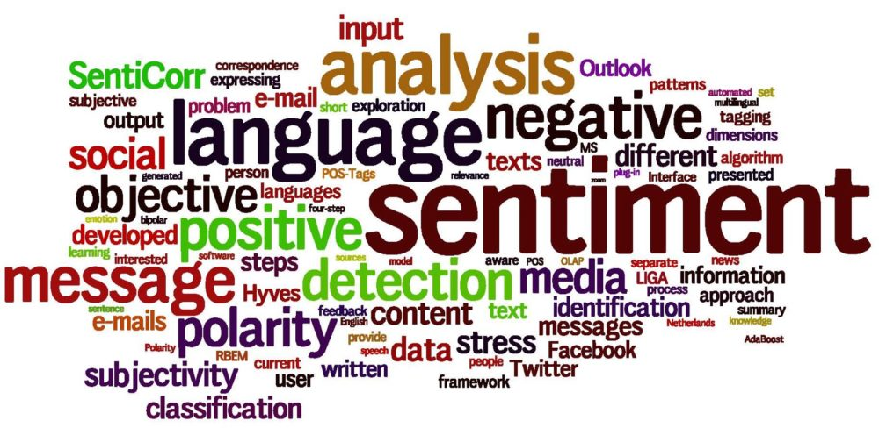

Slide 2
Overview
twitter.com is a popular micro blogging website
Each tweet is 140 characters in length
Tweets are frequently used to express a twitter’s emotion on a particular subject
We aim for analyzing sentiment on Article 370
The challenge is to gather all such relevant data, detect and summarize the overall sentiment.

Slide 3
Problem Statement

Slide 4
What is Sentiment Analysis?

Slide 5
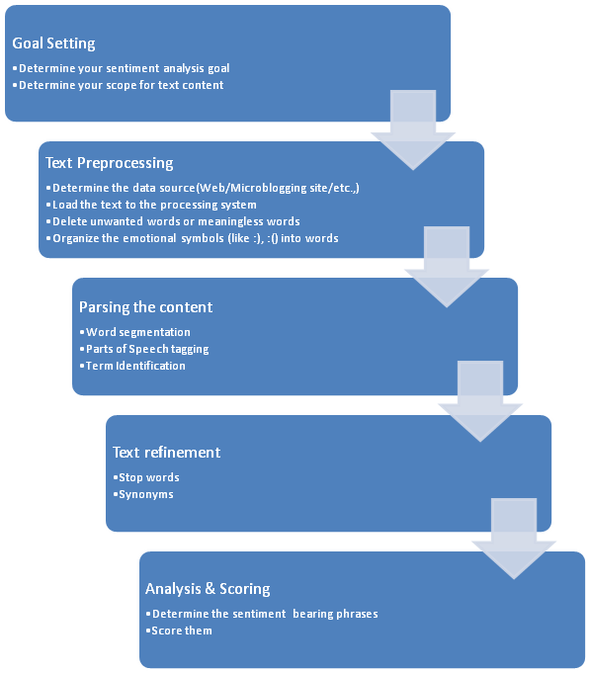
Strategy

Slide 6
Actions(Target Challenges)
Usernames are mentioned more often than not: Usually they consist of some alphabets and numbers, and do not contribute much towards sentiment classification, except for increasing the size of the feature vector.
URLs are not required in our task.
Repeated letters: People often repeat letters in some words, in order to stress upon a particular emotion. For example:- sad, saaaad, saaaddd.
Hashtags Words in hashtags may be read different from the same word without the hash tag
Punctuations and additional spaces.

Slide 7
Operational Workflow
CSV file of crawled tweets
Preprocessing of tweets
Remove URLs
English Dictionary Creation
Extraction of words
Stemming
Twitter Handle Scrapper
Generation of Sentiment Metric
Vader Sentiment Analysis
WORD CLOUD GENERATION
Text file containing preprocessed word set

Slide 8
Result Metric
Sentiment Metric | Score
Positive
Negative
Neutral
Compound

Slide 9
Business Value
Having insights-rich information eliminates the guesswork and execution of timely decisions.
With the sentiment data about your established and the new products, it’s easier to estimate your customer retention rate.
Based on the reviews generated through sentiment analysis in business, you can always adjust to the present market situation and satisfy your customers in a better way.

Slide 10
Future Scope

Slide 11
References

